Slide 1
Project Proposal: Barman’s helper
Vlăduțu Daria Elena
236578

Slide 2
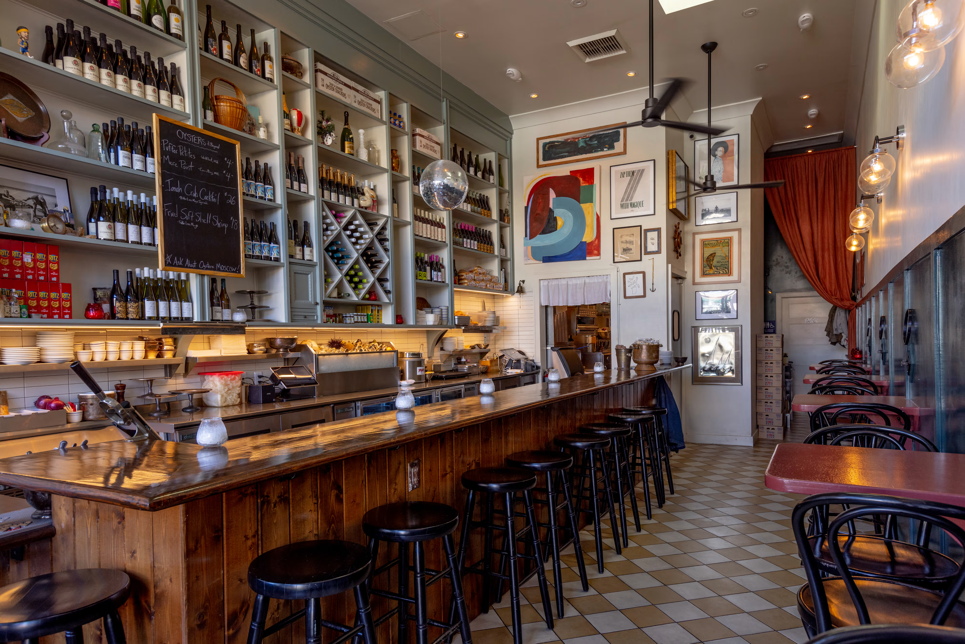
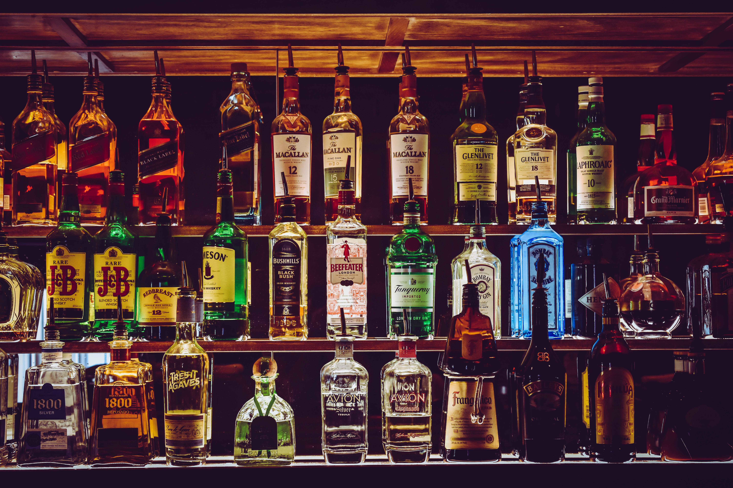
Project Pitch
Business Understanding
Inventory management can pose a serious challenge for bars and restaurants.
As Retail Focus (2023) reports, inventory management issues are the second most common challenges that bars and restaurants face.
The main stockholder is the restaurant/ bar owner.
Notes:
2 MINUTES
INTRODUCTION:
- Inventory management can pose a serious challenge for bars and restaurants. Misjudging the quantities of perishable stock could lead to either an abundance of waste or not enough stock to fulfil orders and maintain customer satisfaction at a constantly high rate. Both scenarios can affect profit.
- As Retail Focus (2023) reports, inventory management issues are the second most common challenges that bars and restaurants face. Since this industry brought the Netherlands 3.87bn Euros last year alone, it is important to assess these challenges and try to implement a solution that will contribute to mediating this common problem. (Statista Research Department, 2024)
MAIN STOCKHOLDER:
The main stockholder is the restaurant/ bar owner.
As they are the ultimate authority over the restaurant's operations and finances, the owner holds significant decision-making power and bears ultimate responsibility and interest for the success and profitability of the business. As the owner mainly focuses on improving operational efficiency, reducing costs, and enhancing customer satisfaction, their perspective will heavily influence project priorities, resource allocation, and the overall approach to implementing the image classifier solution. Therefore, understanding the needs, goals, and concerns of the restaurant owner is essential for driving project success and securing support for the initiative.
IDEA:
- The main problem I believe my idea would alleviate is profit loss.
- Another problem for which this algorithm would be a solution is lowering employee stress (especially managers) when having to handle a situation where ingredients are not in stock. For example, in a restaurant that primarily serves breakfast and lunch, if the inventory is almost out/ out of coffee grounds, that translates into a huge proportion of the day's profit being lost, since customers that dine at such a restaurant are mainly consuming coffee drinks. In summary, it would alleviate the most common problem, humans being unorganised.
-This would help the staff always have stock on hand, avoiding situations where the organisation would lose money due to customers ordering a specific drink, and the inventory being out of the required ingredient(s).
In summary, it would alleviate the most common problem, humans being unorganised.

Slide 3
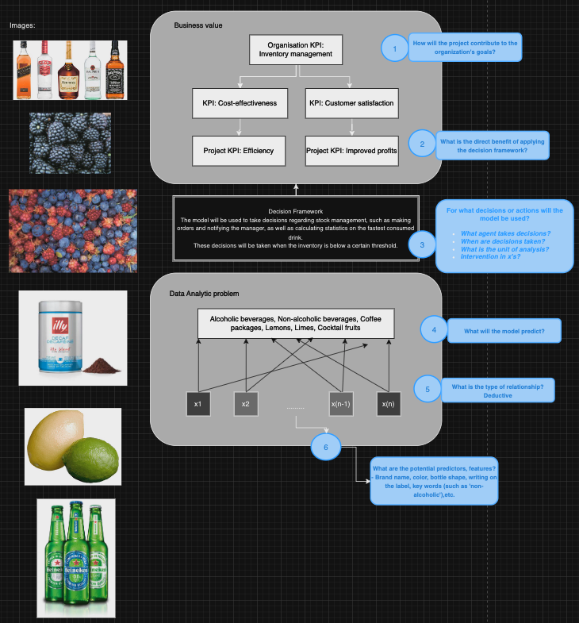
Project Pitch
Business Understanding
The image classifier product that I decided to train would classify objects such as alcoholic beverages bottles, non-alcoholic beverages bottles and cans, cocktail fruits, and coffee grounds packages. This algorithm's purpose would be to help bars/ restaurant bars keep track of the primary inventory and notify the staff when another order is needed. The algorithm would be implemented in a label scanner (such as the one in supermarkets) and would directly send the information to the organisation's cloud system.
Notes:
2 MINUTES
INTRODUCTION:
- Inventory management can pose a serious challenge for bars and restaurants. Misjudging the quantities of perishable stock could lead to either an abundance of waste or not enough stock to fulfil orders and maintain customer satisfaction at a constantly high rate. Both scenarios can affect profit.
- As Retail Focus (2023) reports, inventory management issues are the second most common challenges that bars and restaurants face. Since this industry brought the Netherlands 3.87bn Euros last year alone, it is important to assess these challenges and try to implement a solution that will contribute to mediating this common problem. (Statista Research Department, 2024)
MAIN STOCKHOLDER:
The main stockholder is the restaurant/ bar owner.
As they are the ultimate authority over the restaurant's operations and finances, the owner holds significant decision-making power and bears ultimate responsibility and interest for the success and profitability of the business. As the owner mainly focuses on improving operational efficiency, reducing costs, and enhancing customer satisfaction, their perspective will heavily influence project priorities, resource allocation, and the overall approach to implementing the image classifier solution. Therefore, understanding the needs, goals, and concerns of the restaurant owner is essential for driving project success and securing support for the initiative.
IDEA:
- The main problem I believe my idea would alleviate is profit loss.
- Another problem for which this algorithm would be a solution is lowering employee stress (especially managers) when having to handle a situation where ingredients are not in stock. For example, in a restaurant that primarily serves breakfast and lunch, if the inventory is almost out/ out of coffee grounds, that translates into a huge proportion of the day's profit being lost, since customers that dine at such a restaurant are mainly consuming coffee drinks. In summary, it would alleviate the most common problem, humans being unorganised.
-This would help the staff always have stock on hand, avoiding situations where the organisation would lose money due to customers ordering a specific drink, and the inventory being out of the required ingredient(s).
In summary, it would alleviate the most common problem, humans being unorganised.

Slide 4
Problem Overview
Deep Learning
My classifier, ‘Barman’s helper’, will classify images of an assortment of beverages (non-alcoholic and alcoholic), coffee, as well as fruits that are most found in the barman’s drink preparations, such as lemons, limes, and multiple forest fruits.
The total number of classes is 6:
alcoholic_beverages_bottle: 76 instances
cocktail_fruits: 259 instances
coffee_grounds_package: 106 i.
lemon_lime: 76 i.
non-alcoholic_beverages: 119 i.
non-alcoholic_beverages_bottle: 76 i.
Baseline accuracies:
Random guess: 36%
HLP: alcoholic_beverages_bottle (93.33%), cocktail_fruits(96%), coffee_grounds_package (98%) lemon_lime (100%), non-alcoholic_beverages(97.77%), non-alcoholic_beverages_bottle (80%)
Basic MLP: 61%
Notes:
1 MINUTE
My classifier, ‘Barman’s helper’, will classify images of an assortment of beverages (non-alcoholic and alcoholic), coffee, as well as fruits that are most found in the barman’s drink preparations, such as lemons, limes, and multiple forest fruits. The total number of classes is 6 (alcoholic_beverages_bottle, cocktail_fruits, coffee_grounds_package, lemon_lime, non-alcoholic_beverages, non-alcoholic_beverages_bottle)
The reason for the subsectioned non-alcoholic beverages classes is that I wanted a class with specific brands for non-alcoholic drinks that are more commonly found in the industry (such as Coca Cola) and one class with more general brands.

Slide 5
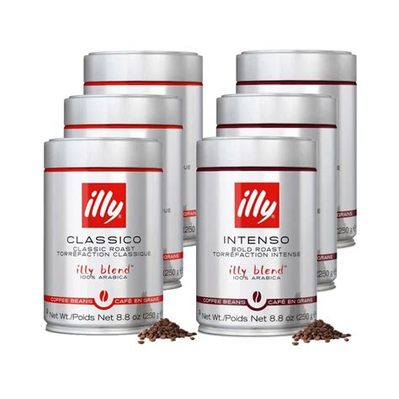
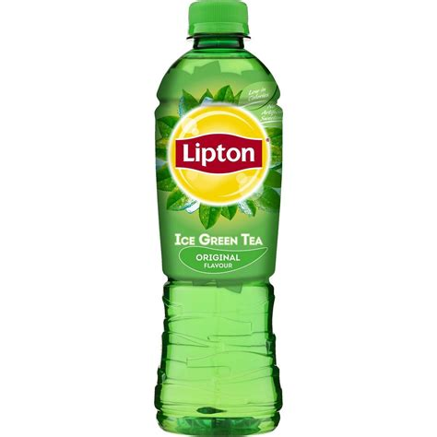
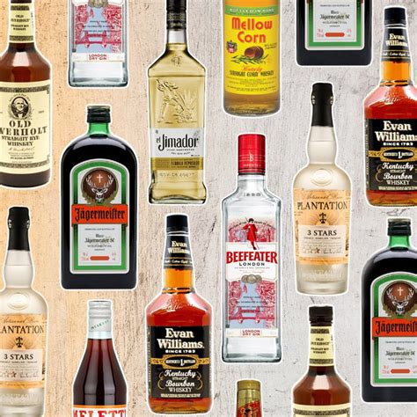
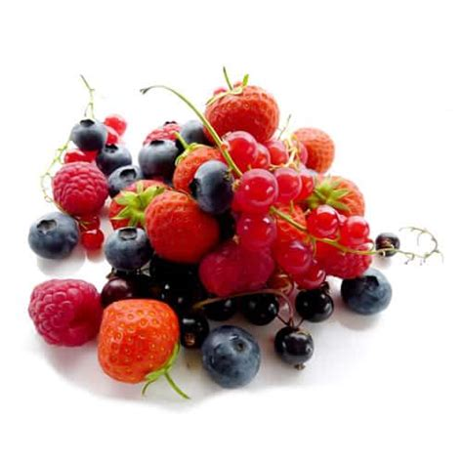
Problem Overview
Deep Learning
non-alcoholic_beverages
alcoholic_beverages_bottle
coffee_grounds
cocktail_fruits
Notes:
My classifier, ‘Barman’s helper’, will classify images of an assortment of beverages (non-alcoholic and alcoholic), coffee, as well as fruits that are most found in the barman’s drink preparations, such as lemons, limes, and multiple forest fruits. The total number of classes is 6 (alcoholic_beverages_bottle, cocktail_fruits, coffee_grounds_package, lemon_lime, non-alcoholic_beverages, non-alcoholic_beverages_bottle)

Slide 6
Model Overview
Deep Learning
First steps for the image classification model:
Preprocessing
Creating the model architecture
Training the model
Model 1: Simple CNN model
8 layers (including output): Convolutional, MaxPooling, Flatten, Dense
Padding: ‘Same’
Optimizer: ‘Adam’
Loss: ‘Categorical Crossentropy’
Metrics: ‘Accuracy and Validation Accuracy’
Model 2: VGG16-based model
5 layers (including output): Flatten, Dense, Dropout
Optimizer: ‘Adam’ (LR = 0.0001)
Loss: ‘Categorical Crossentropy’
Metrics: ‘Accuracy and Validation Accuracy’
Notes:
2 MINUTES
In the preprocessing phase, I decided to preprocess the data in two different ways: by applying common techniques such as reshaping, one-hot encoding, label encoding, and by applying data augmentation. I then split these datasets into training, validation, and test sets to be used on the two different models I have chosen. Since two different preprocessed datasets emerged, 2 iterations ran for each model.
The first model is a simple CNN model. For the second one, I have used a transfer learning approach utilizing the VGG16 model. VGG16 is renowned for its effectiveness in various computer vision tasks, which is the main reason I decided to use it.
READ SLIDE
Due to the restricting input shape of the VGG16 model (224, 224, 3), the kernel size for the simple CNN model had to be adjusted from 2 to 3, to maintain compatibility. Padding had to be set to ‘same’, ensuring that the convolution operation adds padding to the input feature map as necessary to produce an output feature map of the same spatial dimensions. On the contrary, due to normalisation techniques drastically and negatively affecting the VGG16-based model’s performance, causing it to overfit almost instantly, I had to sacrifice applying this preprocessing technique, which had an impact (although not major) on the simple CNN model.
Model training was done using 1000 epochs for the simple model and 100 for the VGG16 model, with Early Stopping as callback (patience of 5)

Slide 7
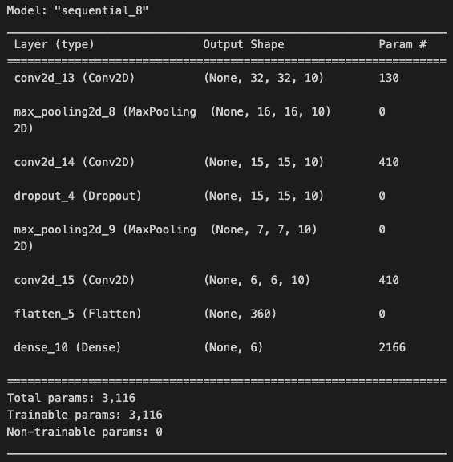
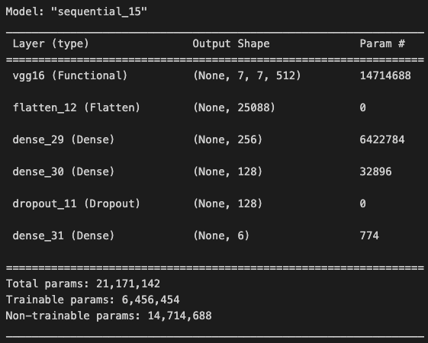
Model Overview
Deep Learning
Model Architecture
Simple CNN model
VGG16- based model
Notes:
Photos for nerds<3

Slide 8
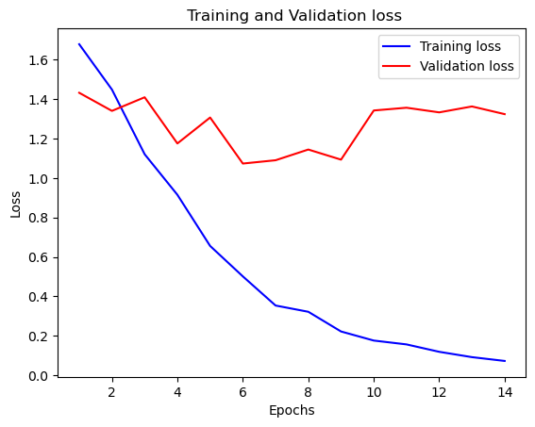
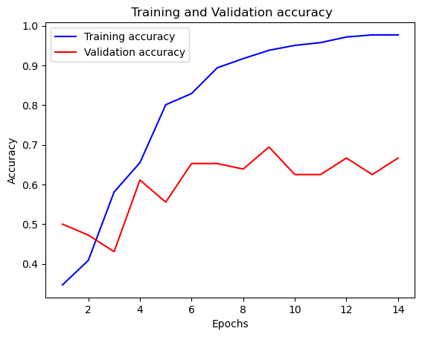
Model Performance
Deep Learning CNN model
Accuracy : 0.65
Val Accuracy: 0.66
Notes:
1 MINIUTE
Due to time constraints, I will only talk about the best performing models.
These are the training and validation loss and accuracy plot for the CNN model usign the basic preprocessed dataset.
The plots seems to indicate overfitting due to training loss decreasing more gradually than the validation loss while training accuracy grows more rapidly and consistently than the validation accuracy during the training process. I hypothesize this is happening because normalising the image values in the preprocessing stage was sacrificed for the VGG16 model's performance.
The model correctly classified about 65.28% of the instances in the test set. This is only a small improvement compared to the MLP's accuracy of 60%. It performs about the same on unseen data.

Slide 9
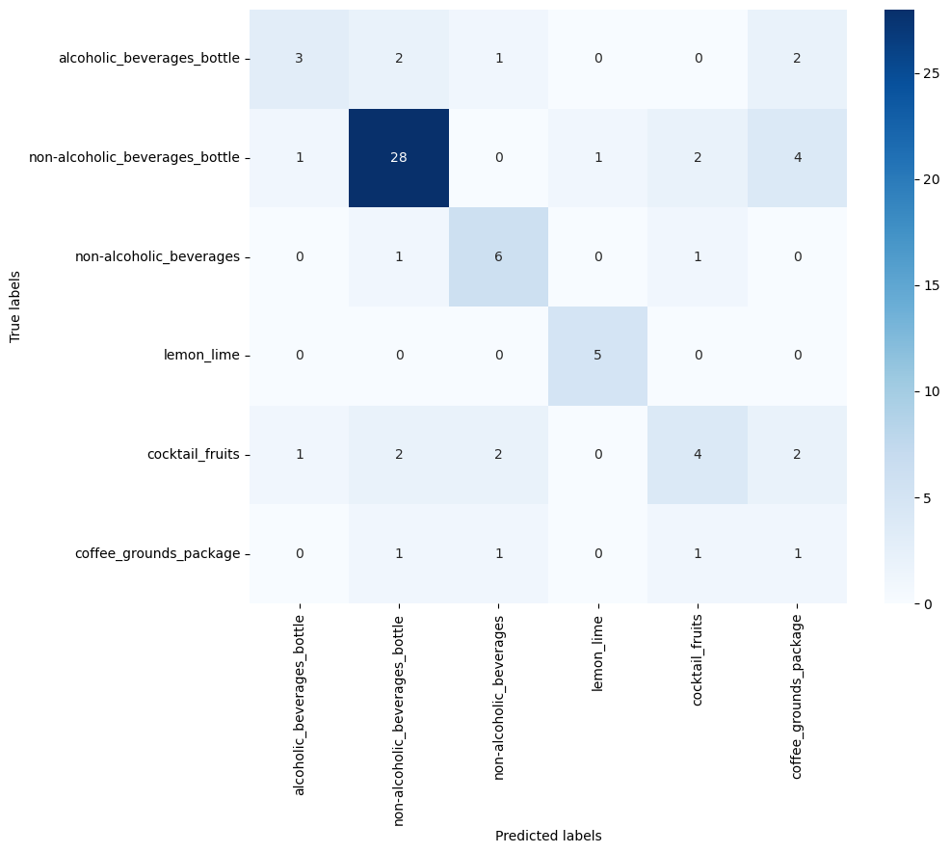
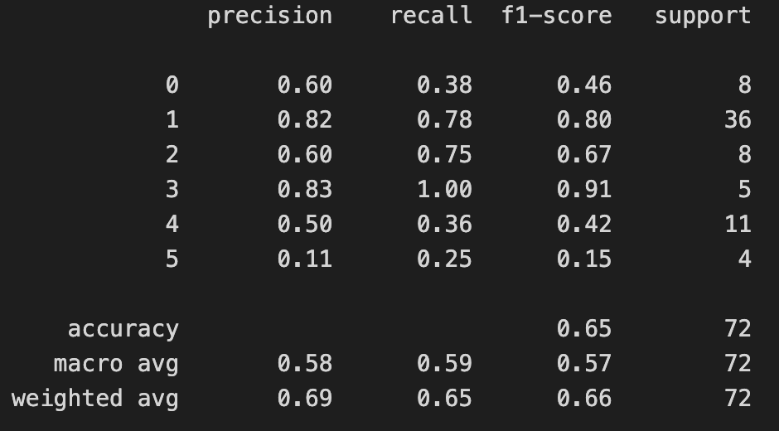
Model Performance
Deep Learning CNN model
The model shows reasonably good performance with an accuracy of 65.28%. However, its performance varies across different classes, with some classes being predicted more accurately than others.
Notes:
1 MINIUTE
ONLY IF U HAVE TIME
From the confusion matrix, we can see that class 4 (cocktail_fruits) has the most misclassifications (7), unlike the HLP, which indicates that cocktail fruits should be easily recognisible. On the contrary, the model does well in predicting class 1, as indicated by the high count of true positives (28).
Some class imbalance in the dataset is indicated by variations in support across different classes in the classification report. However, this was purposely achieved when curating the dataset because some class classifications would be more useful in the application, such as for beverages.
The model shows reasonably good performance with an accuracy of 65.28%. However, its performance varies across different classes, with some classes being predicted more accurately than others.

Slide 10
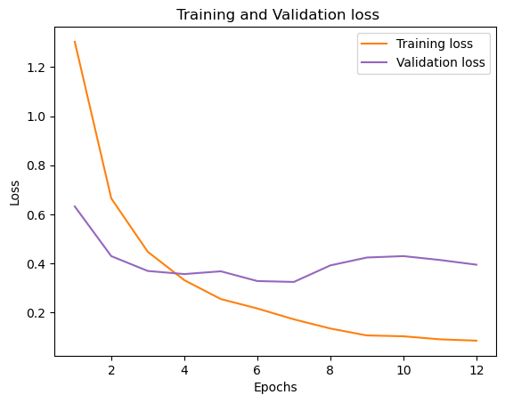
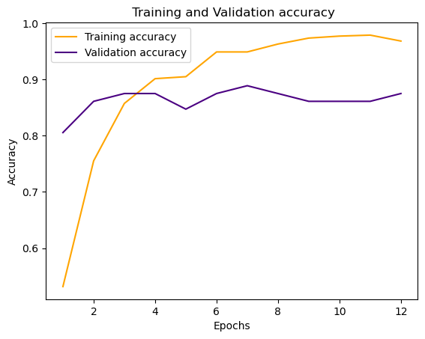
Model Performance
Deep Learning VGG16-based model
Accuracy: 0.86
Val accuracyL 0.87
Notes:
1 MINUTE
These are the training and validaiton loss and accuracy plots for the VGG16-based model using the basic preprocessed dataset.
The plots might indicate overfitting. However, we cannot know for sure as the callback for the model training was only 5.
The overall accuracy of 86.11% indicates that the model performed reasonably well in classifying the test instances. However, it also suggests that there is room for improvement, particularly in distinguishing between classes 0, 4, and 5 (the classes with misclassifications).
It performs about the same on unseen data, which is good.

Slide 11
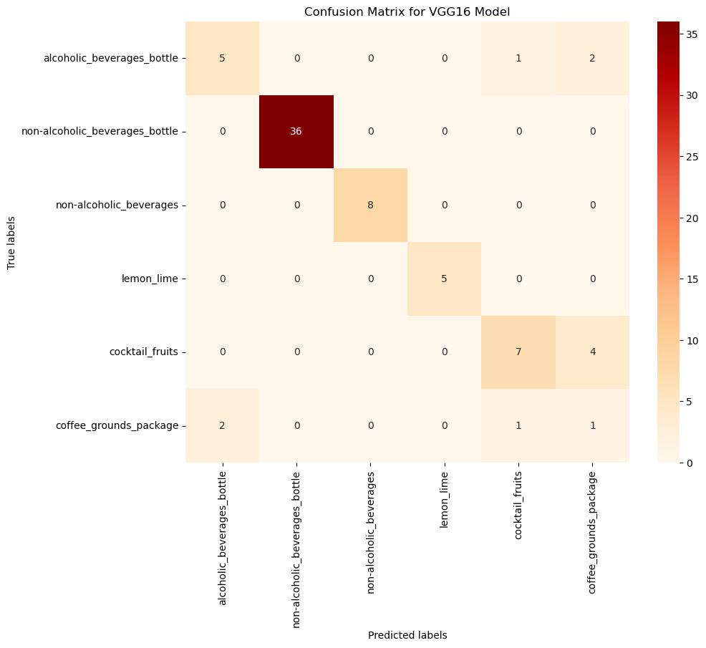
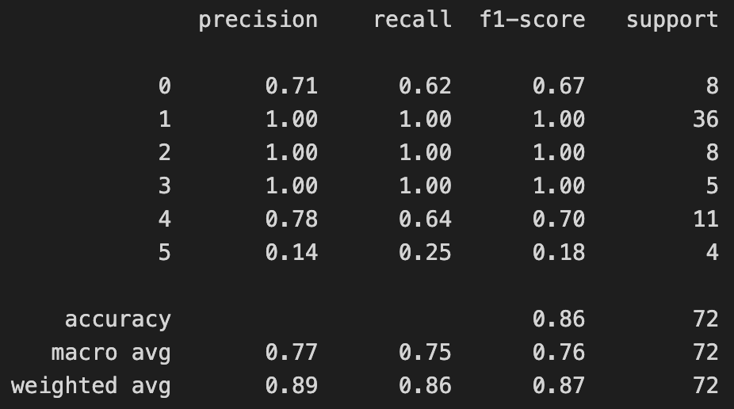
Model Performance
Deep Learning CNN model
The model shows reasonably good performance with an accuracy of 65.28%. However, its performance varies across different classes, with some classes being predicted more accurately than others.
Notes:
1 MINIUTE
ONLY IF U HAVE TIME
Class 1, 2 and 3 have perfect precision, recall and F1-score values, indicating accurate classification for said classes
For class 0: the precision of 71% indicates that when the model predicts class 0, it is correct 71% of the time. The recall of 62% suggests that the model correctly identifies 62% of actual class 0 instances.
For class 4: The precision of 78% indicates that when the model predicts class 4, it is correct 78% of the time. The recall of 64% suggests that the model correctly identifies 64% of actual class 4 instances.
For class 5: The low precision, recall, and F1-score for class 5 indicate challenges in correctly identifying and classifying instances of this class.

Slide 12
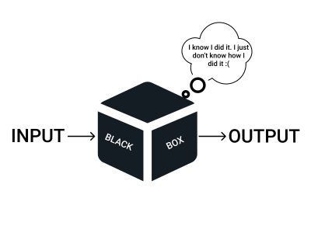
Model Interpretability
Responsible AI
Accuracy vs. Interpretability?
CNNs, with their many layers and interconnected neurons, excel at accuracy but often lack interpretability.
Underlying patterns?
Integrated Gradients address some limitations of vanilla gradients.
SHAP (SHapley Additive exPlanations) method as connects optimal credit allocation with local explanations.
Notes:
2 MINUTES
CNNs, with their many layers and interconnected neurons, excel at accuracy but often lack interpretability. The infamous AI black box– the input goes in, the classification comes out, but the internal logic can be opaque.
In the context of my model, I hold accuracy at a higher level than interpretability simply because it is a simple model designed to aid HoReCa workers, specifically managers. Therefore, it is not that important in this context that users or observers of users to fully understand the concepts. However, a fair and thorough explanation should be given so the workers are able to properly use the application.
I have implemented Integrated Gradients as this method addresses some limitations of vanilla gradients by calculating the integral of the gradients along a path from a baseline image to the actual input image. This provides a smoother and more accurate attribution map compared to vanilla gradients, highlighting the cumulative influence of each pixel on the final decision. Additionally, I have applied the SHAP (SHapley Additive exPlanations) method as connects optimal credit allocation with local explanations.

Slide 13
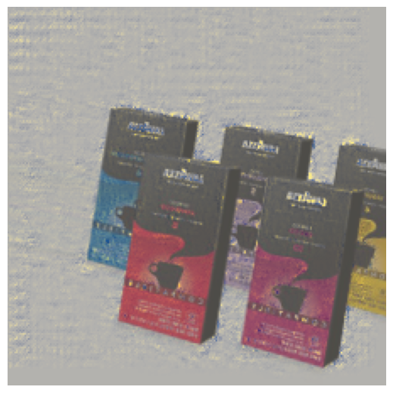
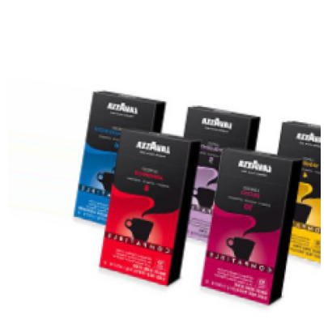
Model Interpretability
Responsible AI
Integrated Gradients results:
Notes:
2 MINUTES
For the alcoholic beverages category: Based on the Integrated Gradients and SHAP explanations, it can be concluded that the model uses bottle shape and colour as features to categorize inputs.
For coffe grounds: Based on the Integrated Gradients and SHARP explanations, it can be concluded that the model uses the shape of packaging, symbols such as coffee cups on the packaging, and key words such as 'Lavazza' as features to categorize inputs. However, as the SHAP explanations show, the model is not able to explain the difference between the two types of coffee grounds. It incorrectly puts high importance on irrelevant superpixels, such as background colour changes. This could explain why this cattegory is one of the most missclassified (based on Error Analysis in 3.6), as well as these specific set of images (cans of ILLY coffee grounds).

Slide 14
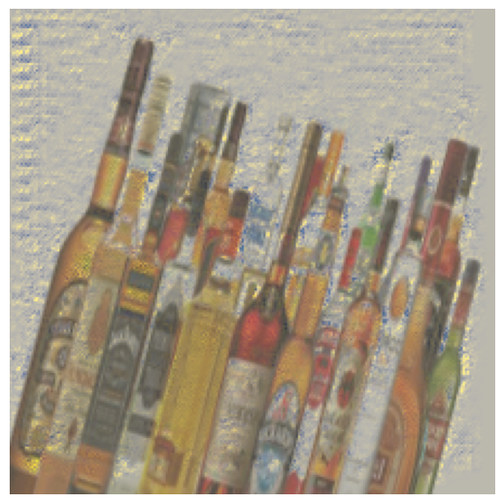
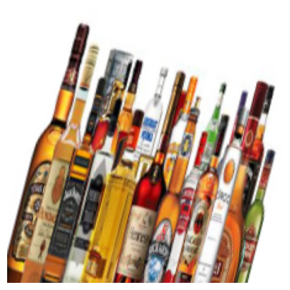
Model Interpretability
Responsible AI
Integrated Gradients results:
Notes:
2 MINUTES
For the alcoholic beverages category: Based on the Integrated Gradients and SHAP explanations, it can be concluded that the model uses bottle shape and colour as features to categorize inputs.
For coffe grounds: Based on the Integrated Gradients and SHARP explanations, it can be concluded that the model uses the shape of packaging, symbols such as coffee cups on the packaging, and key words such as 'Lavazza' as features to categorize inputs. However, as the SHAP explanations show, the model is not able to explain the difference between the two types of coffee grounds. It incorrectly puts high importance on irrelevant superpixels, such as background colour changes. This could explain why this cattegory is one of the most missclassified (based on Error Analysis in 3.6), as well as these specific set of images (cans of ILLY coffee grounds).

Slide 15
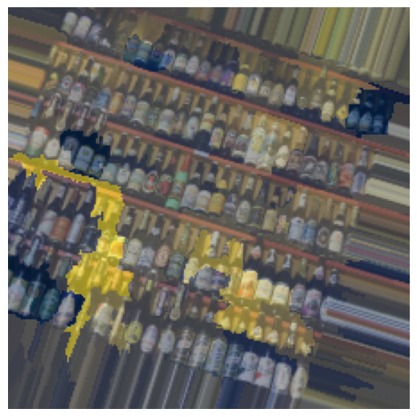
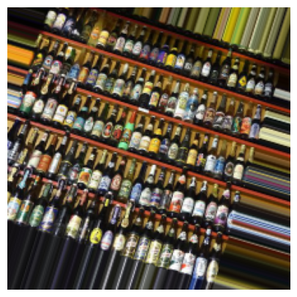
Model Interpretability
Responsible AI
SHAP results:
Notes:
2 MINUTES
For the alcoholic beverages category: Based on the Integrated Gradients and SHAP explanations, it can be concluded that the model uses bottle shape and colour as features to categorize inputs.
For coffe grounds: Based on the Integrated Gradients and SHARP explanations, it can be concluded that the model uses the shape of packaging, symbols such as coffee cups on the packaging, and key words such as 'Lavazza' as features to categorize inputs. However, as the SHAP explanations show, the model is not able to explain the difference between the two types of coffee grounds. It incorrectly puts high importance on irrelevant superpixels, such as background colour changes. This could explain why this cattegory is one of the most missclassified (based on Error Analysis in 3.6), as well as these specific set of images (cans of ILLY coffee grounds).

Slide 16
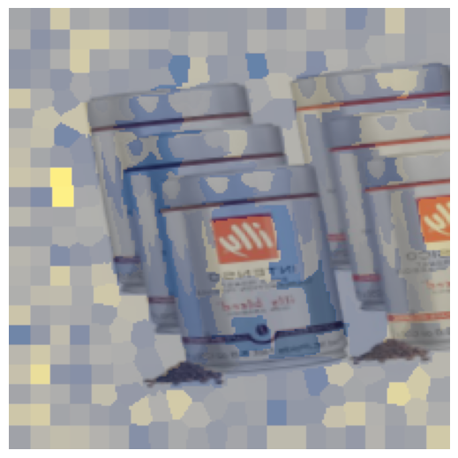
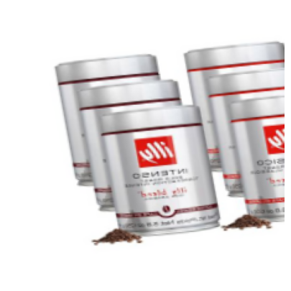
Model Interpretability
Responsible AI
SHAP results:
Notes:
2 MINUTES
For the alcoholic beverages category: Based on the Integrated Gradients and SHAP explanations, it can be concluded that the model uses bottle shape and colour as features to categorize inputs.
For coffe grounds: Based on the Integrated Gradients and SHARP explanations, it can be concluded that the model uses the shape of packaging, symbols such as coffee cups on the packaging, and key words such as 'Lavazza' as features to categorize inputs. However, as the SHAP explanations show, the model is not able to explain the difference between the two types of coffee grounds. It incorrectly puts high importance on irrelevant superpixels, such as background colour changes. This could explain why this cattegory is one of the most missclassified (based on Error Analysis in 3.6), as well as these specific set of images (cans of ILLY coffee grounds).

Slide 17
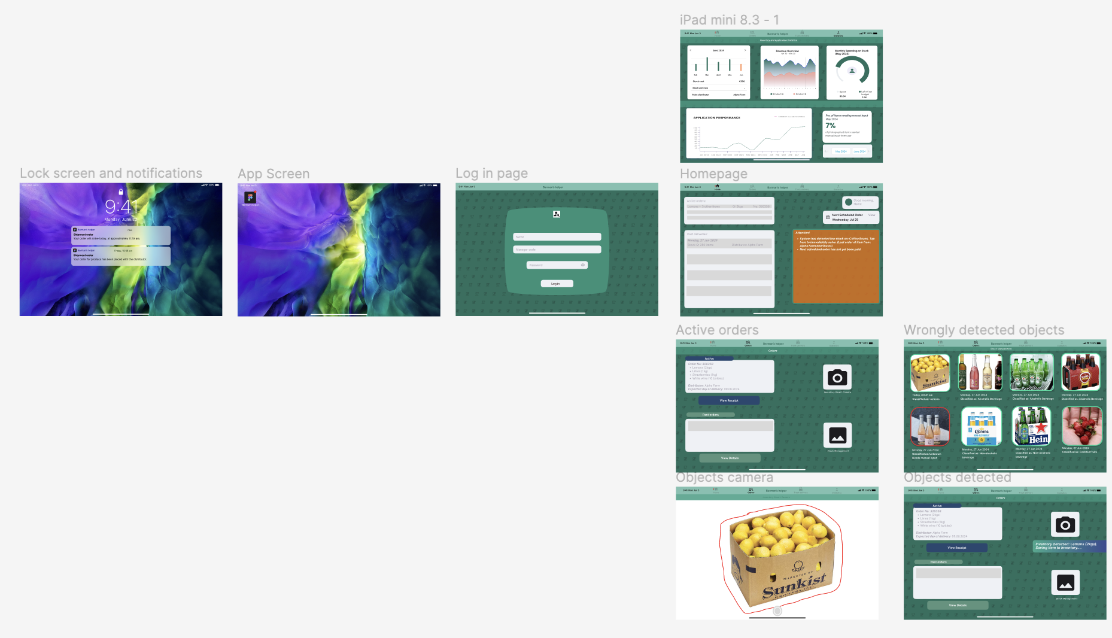
User Study
Human-Centered AI
A
Notes:
1 MINUTE
Before discussing the results of the A/B test, I wanted to showcase the different wireframes used for the test.
This is the A version of the wireframe.

Slide 18
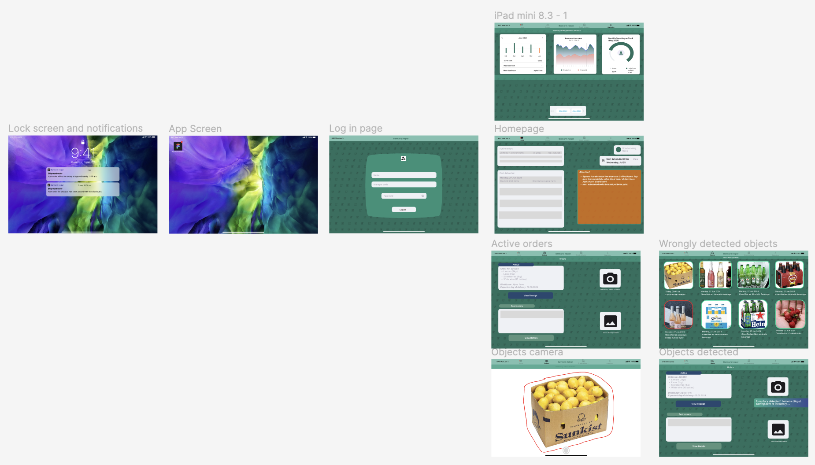
User Study
Human-Centered AI
Notes:
1 MINUTE
This is the B version of the wireframe. The difference may not be noticeable, as it is in only one slide.

Slide 19
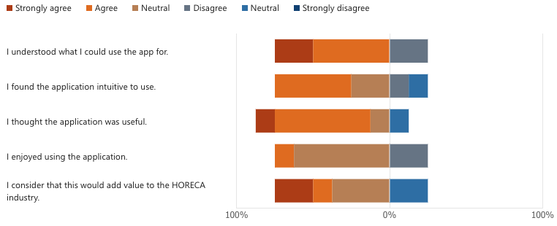
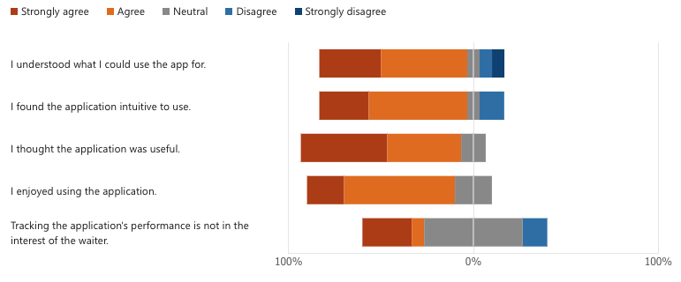
User Study
Human-Centered AI
A/B Test results:
A
B
Notes:
1 MINUTE
Following the A/B testing, I concluded that the three most important findings were that the application's purpose is not necessarily clear to a first-time user, that showing the performance on the app itself would not be of interest to the waiter, and that the interface could be more interactive. This resulted in the final version of my wireframe.

Slide 20
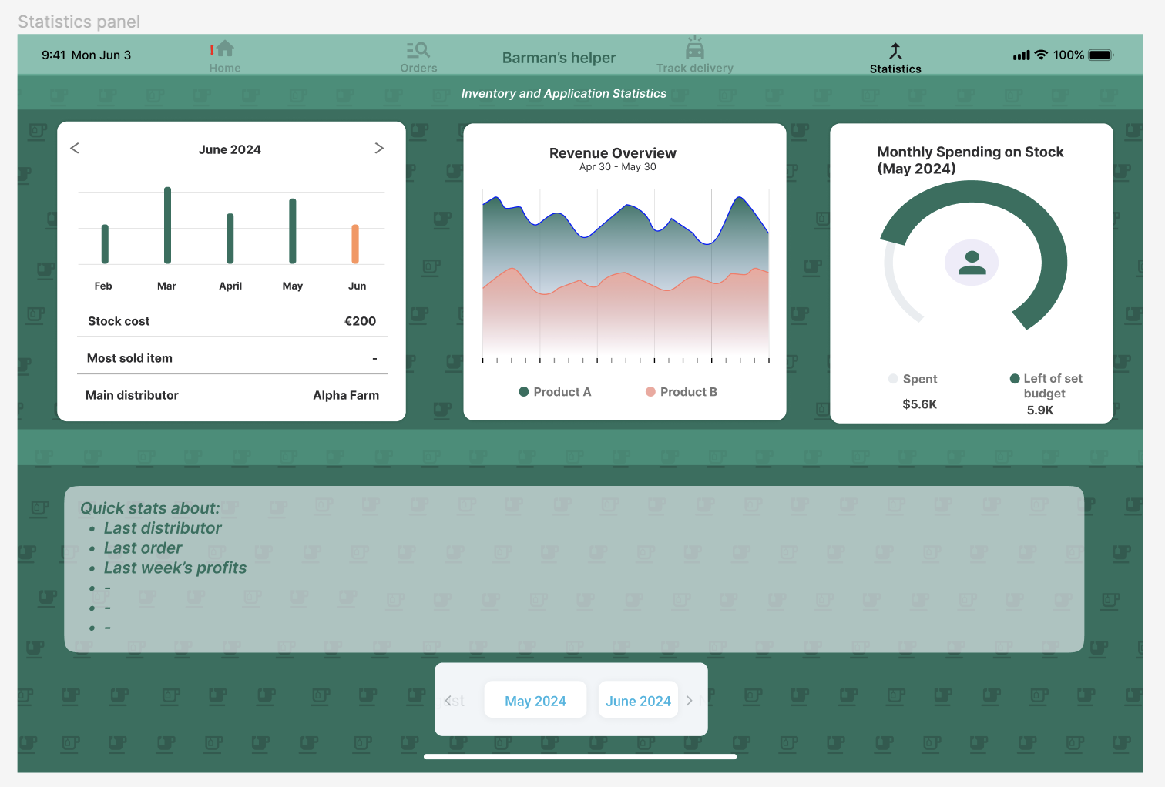
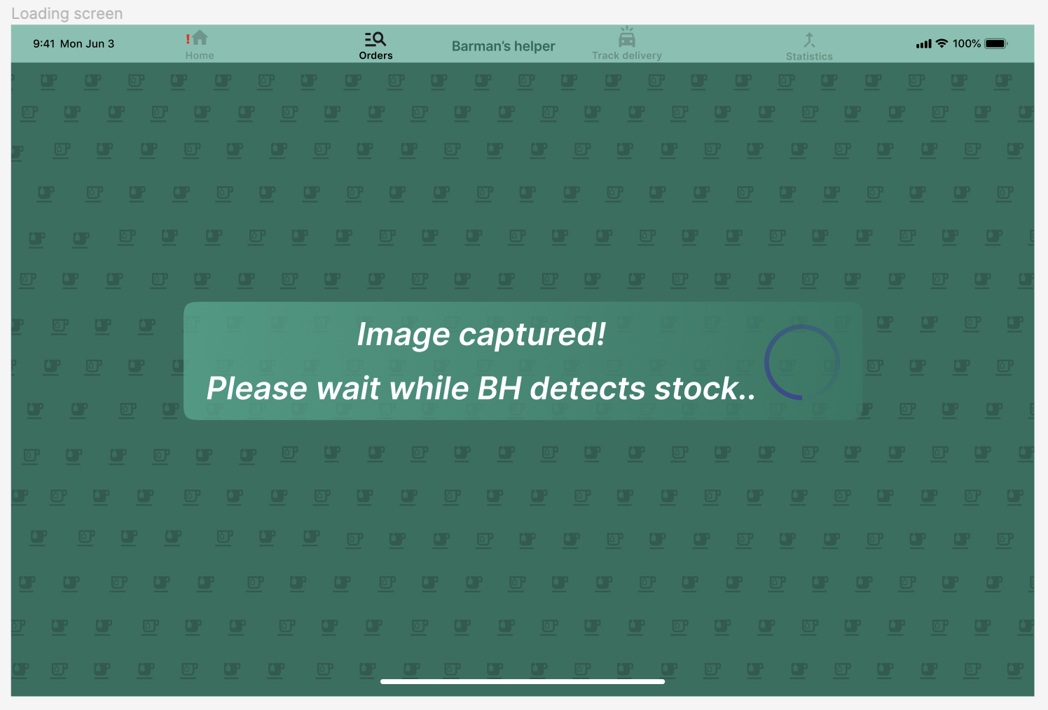
User Study
Human-Centered AI
Notes:
1 MINUTE
I completely removed the performance tracker for the application and replaced it with a quick statistics panel for the actual orders. I also added a loading screen to be a little more clear about the flow of the application.

Slide 21
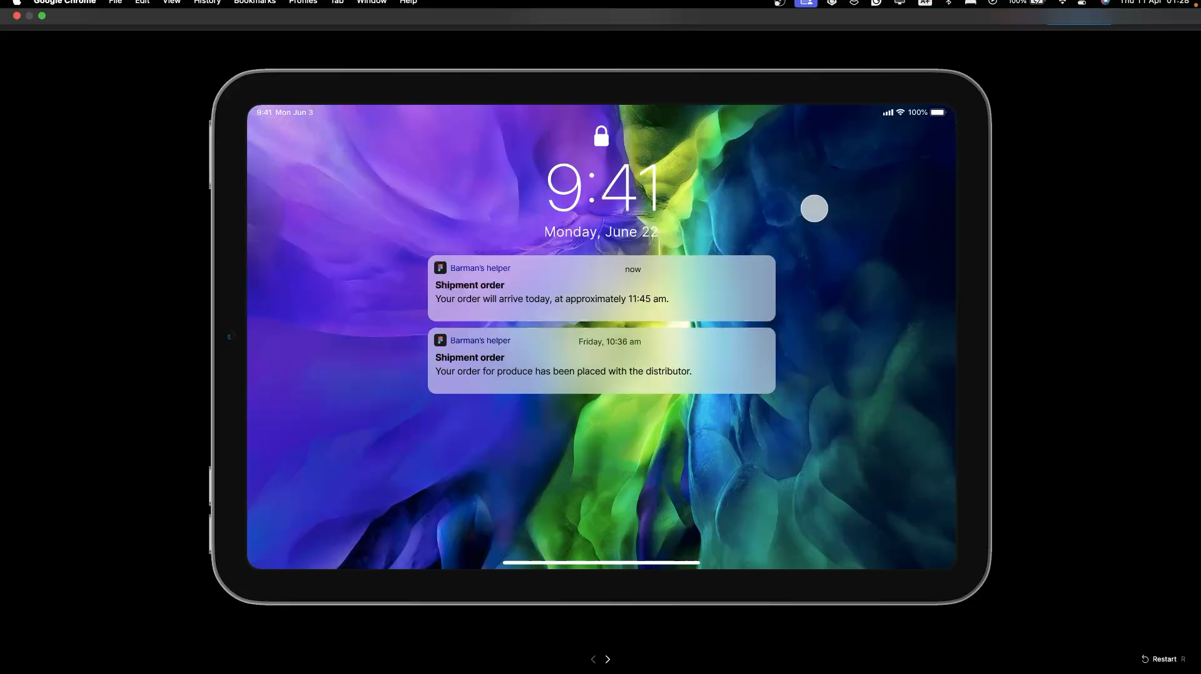
Demo
Human-Centered AI
Notes:
2 MINUTES
Play video
I wanted to quickly mention that the design of my application and most of the features are based on my previous experience working in the HoReCa industry and utilising the technology and software developed specifically fo

Slide 22
Thank you!
Any questions?

